Slide 1
The Detection of Violations of Traffic Rules for Personal Mobility(PM) through CCTV Video Analysis.
201911471 Yunju Jo (Yun)

Slide 2
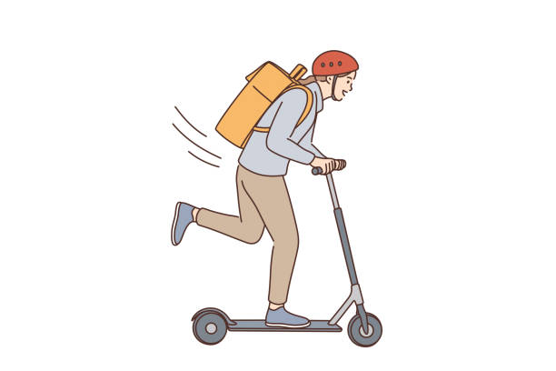
Contents
What is the PM(Personal Mobility)?
Problem Background
Overall Algorithms
AI Architecture to use
Algorithms for AI Models

Slide 3
If you think,
“ I’ve never heard of,
I’ve never seen,
I don’t know what a
personal mobility(PM) is, “

Slide 4
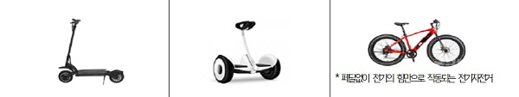
What is the personal mobility(PM)?
What is PM,
According to Korea's Road Traffic Act, "a motorized bicycle with a maximum speed of less than 25 km/h and a vehicle body weight of less than 30 kg.“
Electric Bicycles
without pedals
Electric Kickboards
Electrically Powered Boards

Slide 5
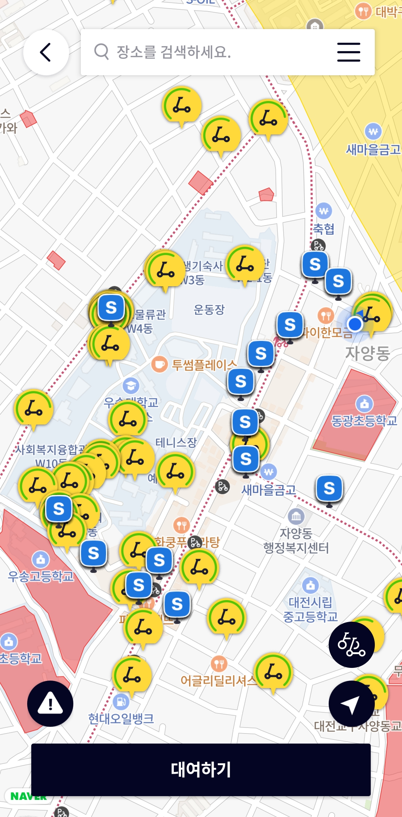
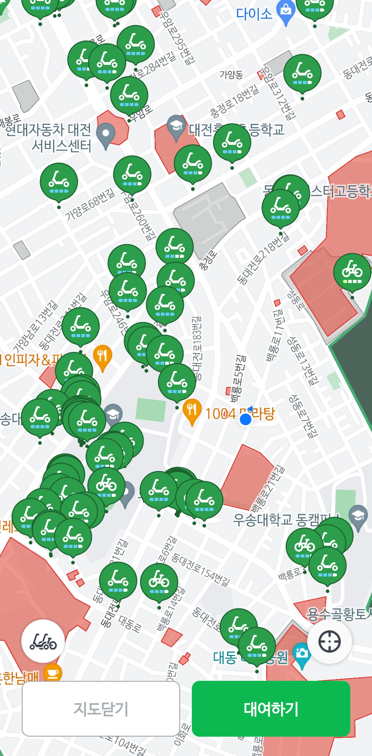
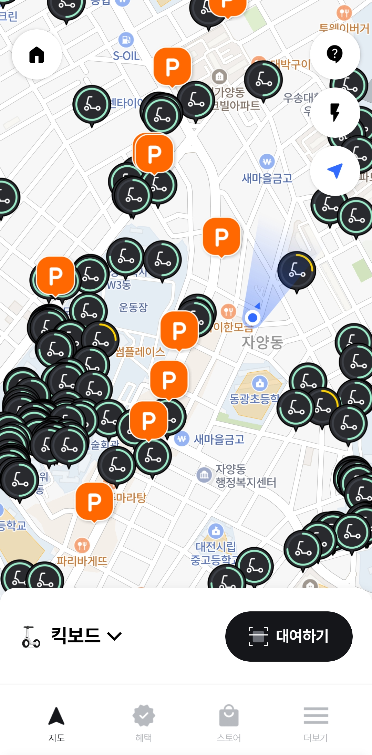

Slide 6
What’s the problem??
Traffic Accident!!!

Slide 7
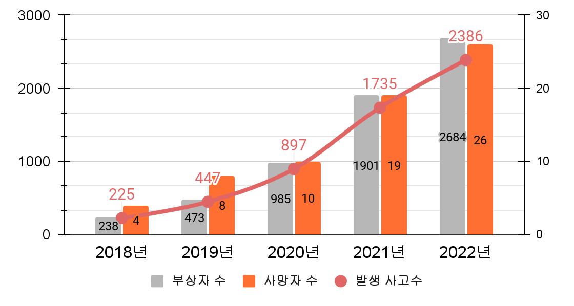
Problem Background
PM's number of accidents and injuries/deaths
injuries
deaths
Accidents
Source: A Statistical Analysis of Traffic Accidents in Road Traffic Authority

Slide 8
Problem Background
Penalties for PM
Punishment Regulations | Fine
Driving without a license | 100,000 won
Punishment of guardians of children under the age of 13 | 100,000 won
Override capacity | 40,000 won
Not wearing a safety helmet | 20,000 won
Luminous device not working | 10,000 won
Driving drugs | 100,000 won
Drunk driving | 100,000 won / 130,000 won
Signal violation, centerline violation, sidewalk driving, cell phone use | 30,000 won
obstruction of pedestrian traffic | 20,000 won
Designated lane traffic violation | 10,000 won
a violation of the ban on parking | 20,000 won / 40,000 won
Source: Road Traffic Authority

Slide 9
Problem Background
We could tackle the issue of enforcing traffic laws on electric kickboards with less human intervention
by using CCTV and a deep learning model designed to detect infractions.
Large-scale regulations will be imposed on electric kickboards, which have been in lawless areas, but there are calls for regulations that are nominal in the field. This is because it is difficult to crack down on wearing safety helmets one by one in a situation where the number of crackdown personnel is limited. An official from Chuncheon District A said, "How can you catch a smaller and faster electric kickboard than a bicycle?" and added, "It is a waste of manpower to crack down on all of the electric kickboards just because you are not wearing a helmet.“
Source: Gangwon-do Provincial Daily (http://www.kado.net )

Slide 10
What’s my solution?

Slide 11



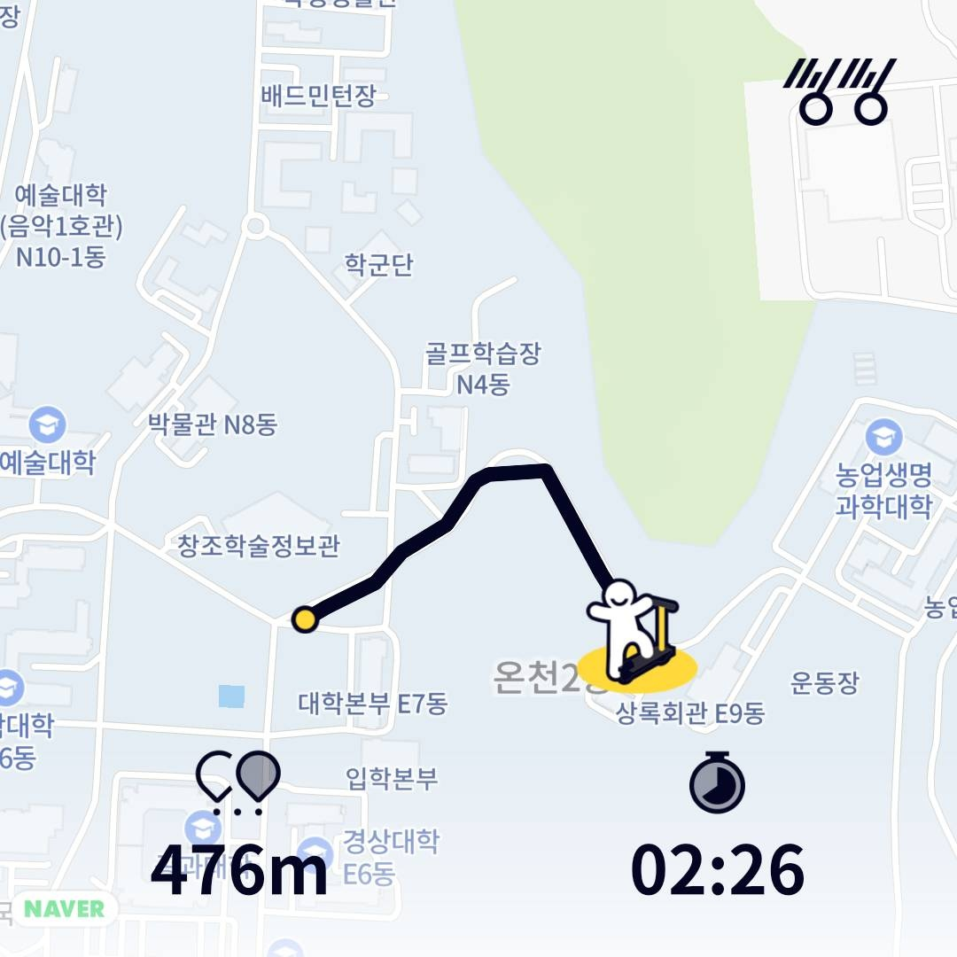



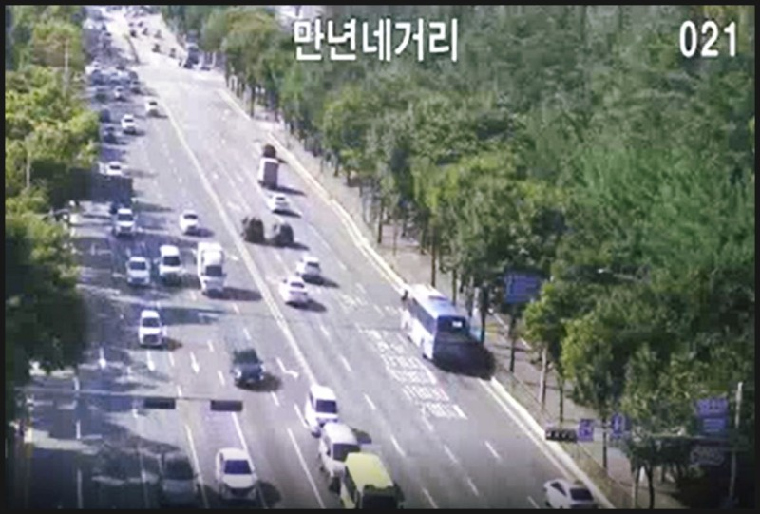

Server
Overall Algorithms
"cctv_id": "CCTV-12345",
"location": { "lat": 37.5665, "lon": 126.9780},
"timestamp": current_time,
"detections":
[ {
"object": results.names[int(detection[5])],
"confidence": float(detection[4]),
"bbox": detection[:4] }
Clients
You're not wearing a helmet. The penalty is 100,000 won.
Helmet.pt
Multi_Rider.pt
Scooter.pt
!
{
ride_ID : RCD_45
user_ID : USER123
ride_start_at : 202308010000
ride_ent_at : 202308010100
ride_time : 202308010200
ride_distance : 476
start_area_code : 41
end_area_code : 11
vehicle_type : 01
created_at : 202308012350
}
CCTV

Slide 12


AI Architecture to use
It is more accurate compared to its speed.
→ WHY? The image inputs are not being processed or analyzed multiple times
We need,
AI model that detects people without helmets
AI model that detects PMs with excess people on board
AI model that detects scooters running at speeds over 10km/h on pedestrian roads.
It is more clearly distinguishes areas.
WHY?
Contracting Path and Expansive Path.

Slide 13

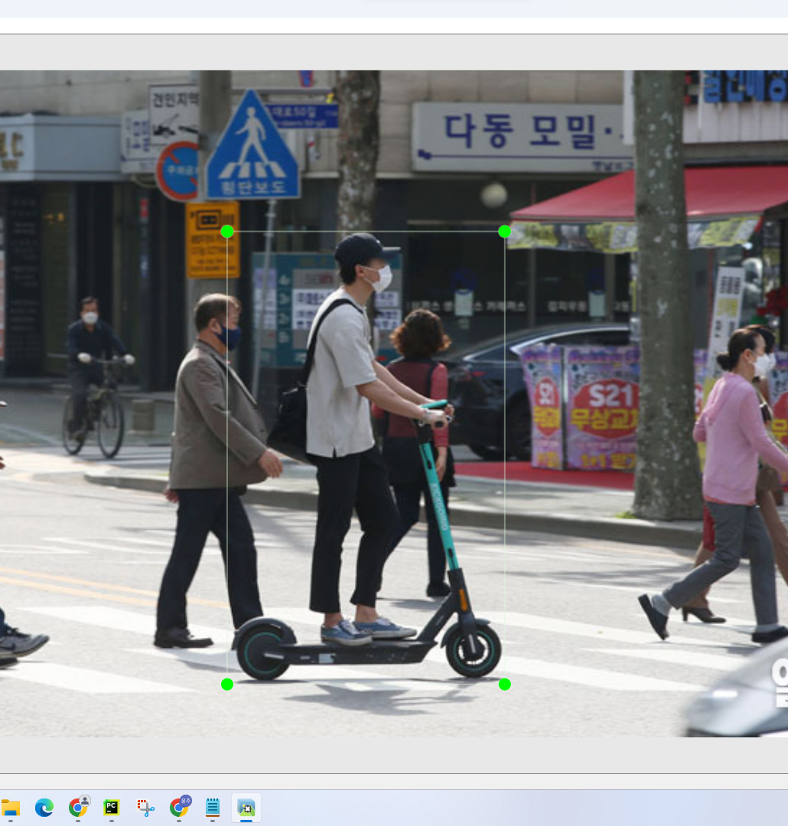
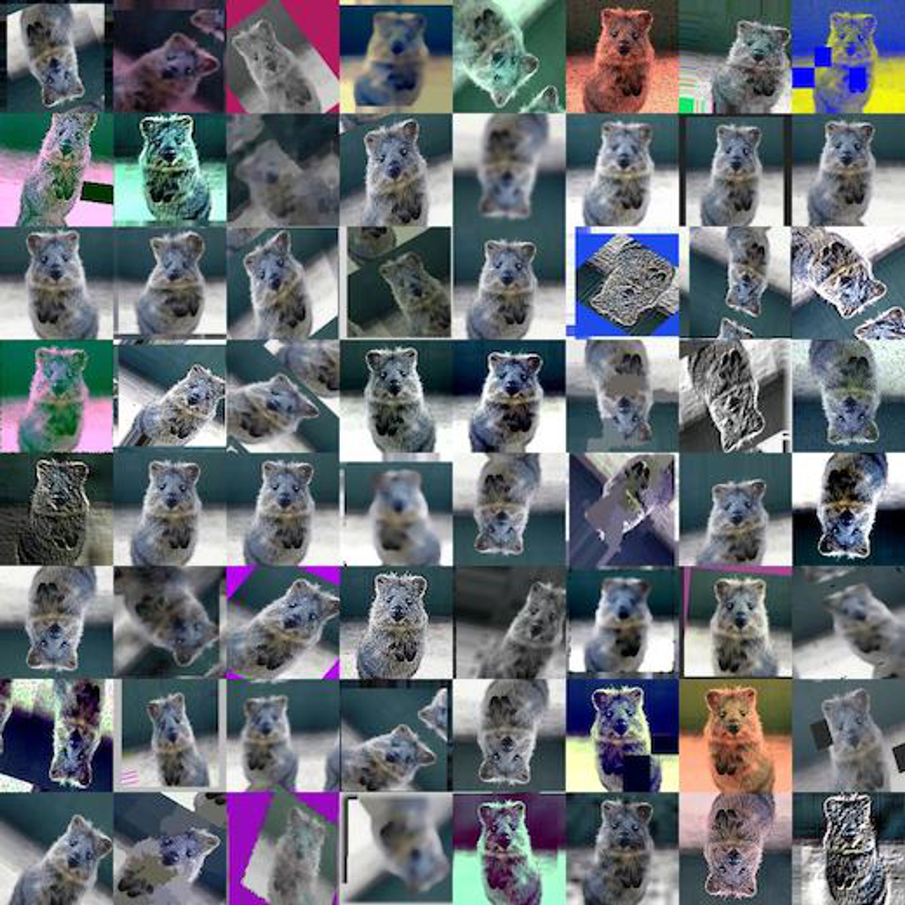
Algorithms for AI models
(Helmet Detection & Multiple Driver Detection)
Import dataset
Label the image to extract the label
Data augmentation
Training

Slide 14
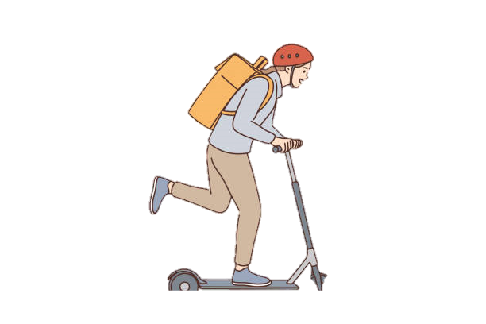
Algorithms for AI models
(Speeding detection in designated areas)
①
According to Lee Min-seop's vehicle traffic and speed measurement using Yolov65 and opencv, the formula for finding the speed of objects in the video is,
②
Scooter
③
Velocity =
Actual Distance / Duration * 3.6* α
α : Number of frames in the output image
Source: Min-Seop Lee, Ji-Young Woo, Yoon-Young Nam. (Date of Conference). Vehicle Traffic and Speed Measurement Using YOLOv5 and OpenCV. Proceedings of the Korea Computer Information Society Conference, Location of Conference.

Slide 15
Test Video

Slide 16
References
Korea Road Traffic Authority. (2019-2023). Road Traffic Accident Statistics.
Min-Sub Lee, Ji-Young Woo, and Yoon-Young Nam. Vehicle Traffic and Speed Measurement using Yolov5 and OpenCV. Proceedings of the Korea Computer Information Society Conference, Venue.
Hee-Moon Yang, “Mandatory Helmets for Electric Scooters? 'How to Enforce?'”, Gangwon People's Daily, April 13, 2021.
Hye-jin Lee, Eun-ji Lee, So-hyun Park, Sun-young Ihm, and Young-ho Park. "Vehicle Recognition and Counting Method based on YOLOv3 in Videos." Proceedings of the Korea Information Processing Society Conference, Vol. 26, No. 2 (2019): 935-938.

Slide 17
The Detection of Violations of Traffic Rules for Personal Mobility(PM) through CCTV Video Analysis.
201911471 Yunju Jo (Yun)
Thank you ☺

